Slide 1
Atrophic Rhinitis

Slide 2
Common Terms: Atrophic Rhinitis
Ozena
Dry Rhinitis
Rhinitis Sicca
Open-nose syndrome

Slide 3
Introduction
Atrophic Rhinitis is an uncommon disorder in modern societies.
While it occurs most commonly today in developing countries or arid climates, it is becoming more common as sequel of medical intervention.

Slide 4
Clinical Features
Anosmia
Ozena, i.e. foul odour
Extensive nasal crusting
Subjective nasal congestion
Enlargement of the nasal cavity
Resorption or absence of turbinates
Squamous metaplasia of nasal mucosa
Depression

Slide 5
The first sign often is the smell of the patient.
In some cases, this can be severe. Paradoxically, this likely will cause distress to everyone except the patient, due to the prevalent finding of anosmia.
Patients may relate that others have informed them of the smell.

Slide 6
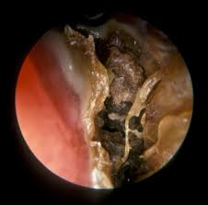
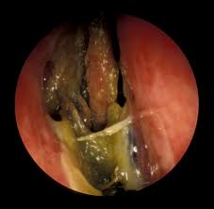
The crusts are often extensive.
Removal of these crusts may induce bleeding.
Once the crusts are removed the mucosa is generally atrophic, with elements of squamous metaplasia present

Slide 7
The volume of the nasal cavity may appear large, either due to absence of turbinate tissue, or lateralization of the lateral nasal walls.
Purulent discharge and septal perforations are not uncommon.

Slide 8
Atrophic Rhinitis
Primary
Secondary

Slide 9
Primary Atrophic Rhinitis
History of prior sinus surgery, radiation, granulomatous disease, or nasal trauma are exclusions.
Most cases are reported in China, Egypt, and India
Microbiology of primary AR is almost uniformly Klebsiella ozenae.
Radiographic and clinical features similar to secondary AR.

Slide 10
Secondary Atrophic Rhinitis
Complication of sinus surgery (89%)
Complication of radiation (2.5%)
Following nasal trauma (1%)
Sequlae of granulomatous diseases (1%)
Sarcoid
Leprosy
Rhinoscleroma
Sequlae of other infectious processes
Tuberculosis
Syphilis

Slide 11
Athough infection may not be the causative agent in secondary AR, superinfection is uniformly present, and is the cause of the crusting, discharge, and foul odor.
In these cases, K. ozenae comprises a small proportion of secondary infections.

Slide 12
Microbiology
Klebsiella ozenae
May be found in almost 100% of primary AR
No predominance in secondary AR
Staphylococcus aureus
Proteus mirabilis
Escherichia coli
Corynebacterium diphtheriae

Slide 13
Other Suggested Causes
Infectious: Primary AR is almost always associated with a single organism K. ozenae.
Dietary: Anemia, hypolipoproteinaemia, vitamin A deficiency
Hereditary: An autosomal dominant inheritance pattern
Hormonal: Worsening of the disease has been reported with menstruation or pregnancy
Vascular: Overactive sympathetic activity

Slide 14
X Ray Para Nasal Sinuses
Lateral bowing of the nasal walls
Reduced or absent turbinates
Hypoplastic maxillary sinuses.

Slide 15
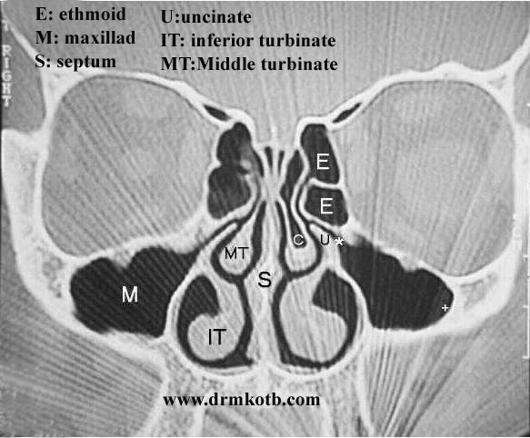
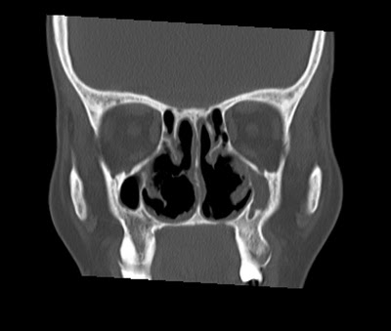
CT Para Nasal Sinuses
Normal
Atrophic Rhinitis

Slide 16
CT Para Nasal Sinuses
Mucoperiosteal thickening of the paranasal sinuses
Hypoplasia of the maxillary sinus
Enlargement of the nasal cavities with erosion and bowing of the lateral nasal wall.
Bony resorption and mucosal atrophy of the middle and inferior turbinates.

Slide 17
Mucosal changes
In atrophic rhinitis, the epithelial layer undergoes squamous metaplasia, and subsequent loss of cilia. (This contributes to loss of nasal clearance, and failure to clear debris).
The mucous glands are severely atrophic or absent, which results in the common term “rhinitis sicca”.

Slide 18
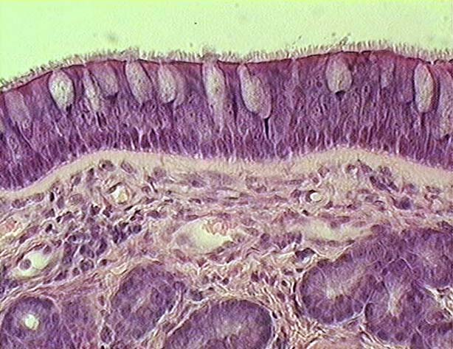
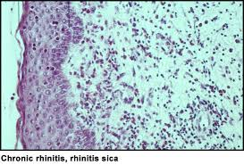

Slide 19
Current Therapies
Goals of therapy
Restore nasal hydration
Minimize crusting and debris

Slide 20
Therapy options
Topical therapy
Saline irrigations
Antibiotic irrigations
Systemic antibiotics
Implants to fill nasal volume
Closure of the nostrils

Slide 21
Nasal Irrigation
Irrigations are used to prevent the formation of the hallmark extensive crusting.
Irrigations must often be done multiple times in a day.
Suggested formulas include normal saline, a sodium bicarbonate saline solution, or a mixture of sodium carbonate, sodium biborate, and sodium chloride in plain water.
No evidence of benefit of one solution over the other has been noted

Slide 22
Nasal irrigation with curative intent
Solutions given for “curative” intent are used to eliminate purulent discharge and colonization of odor producing bacteria.
One of these is Gentamycin 80mg in 1L of normal saline.
This is given until resolution of purulence and foul odor

Slide 23
Other topical methods
These are used to prevent drying or increase hydration.
These include the application of anti-evaporation compounds: glycerine, mineral oil, or menthol mixed with paraffin.
Hydration therapies include the application of pilocarpine or atropine to the mucosa to stimulate the remaining mucous glands.

Slide 24
Systemic or oral therapies
Used in conjunction with the topical treatments.
Oral aminoglycoside antibiotics or streptomycin injections, Tetracycline or a floroquinolone
Other therapies have been suggested based on individual responses.
These include potassium iodide to increase nasal secretions
Vasodilators to increase blood flow to the atrophic mucosa
Estrogen therapy to prevent the worsening that may be associated with menstruation.

Slide 25
Surgical therapies
Young procedure
Modified Young procedure
Turbinate reconstruction
Volume reduction procedures
Denervating operations

Slide 26
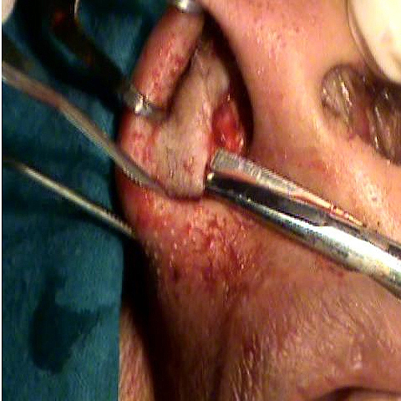
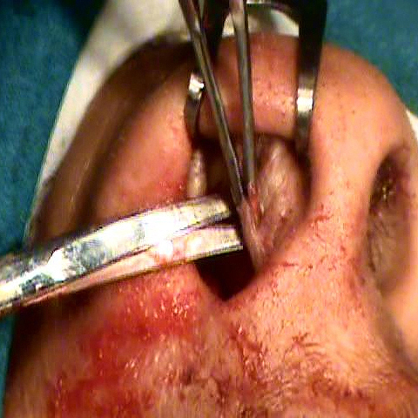
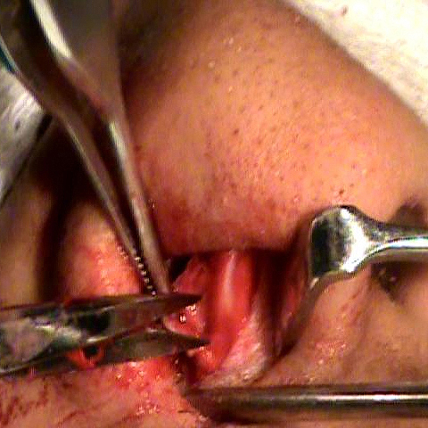
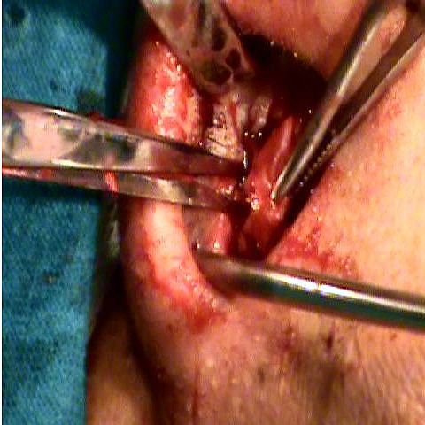

Slide 27
Volume reduction procedures
Commonly described procedures using natural material include autograft bone, dermofat, cartilage,
Xenograft substances such as boplant.
Foreign materials include silicon, silastic, acrylic, teflon, hydroxyapatite, or plastipore

Slide 28
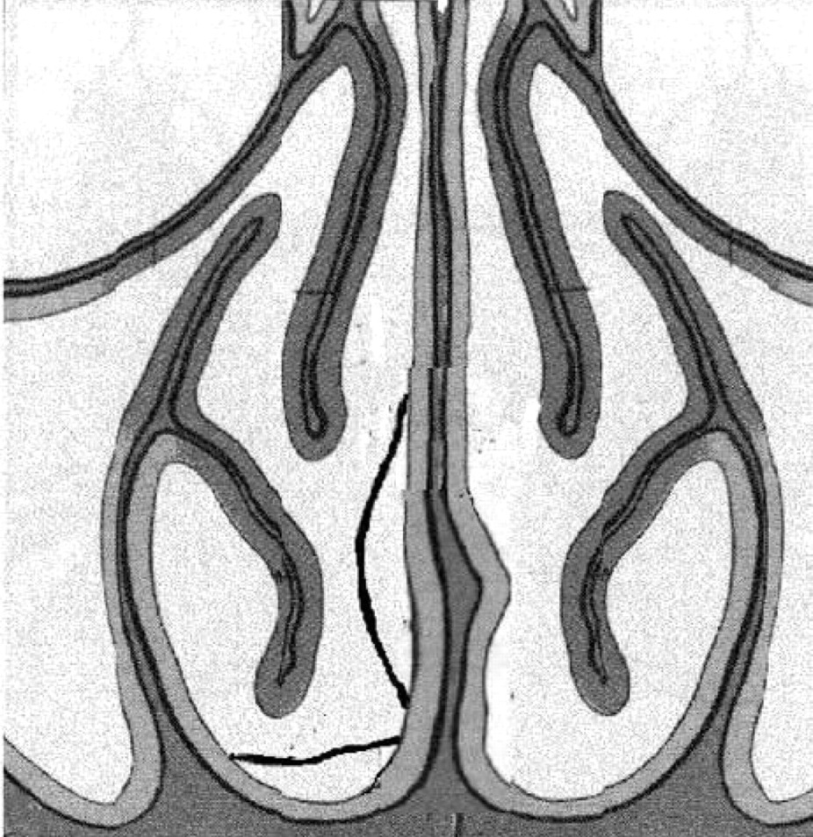
Plastipore implantation
Porus material allows tissue ingrowth.
Implants shaped then fenestrated for ingrowth.
Implants placed submucosally along the septum and nasal floor.

Slide 29
Denervation Procedures
The denervating operations are based on the conclusion that sympathetic overactivity plays an integral role in the pathogenesis of this disease
Cervical sympathectomy
Stellate ganglion block
Sphenopalatine ganglion block
Section of greater superficial petrosal nerve

